Slide 1
General Service Representative (GSR)
Workshop
Area 23

Slide 2
Schedule of Events
Third Legacy; Commitment to Home Group/District/Area 23, and Registering with GSO
Importance and use of A.A. Service Manual, Robert’s Rules of Order, & Area 23 Structure Manual and Guidelines
Guardian of Traditions, and Being involved in Service work at the District and Area Level;
Roles and Responsibilities of the GSR, Group Conscious, and suggested ways to be involved.
Questions/Closing

Slide 3
Officers
Chairperson Charlotte Crabtree chairperson@area23aa.org | Alternate Chairperson Heather Gottbrath alternatechair@area23aa.org | Delegate Janet Flikke delegate@area23aa.org 812-760-9378 | Alternate Delegate Paul Logan alternatedelegate@area23aa.org 317-445-1504
Secretary Christina Watts secretary@area23aa.org | Alternate Secretary Dawn Wiseman alternatesecretary@area23aa.org | Treasurer Ellery Likens treasurer@area23aa.org 812-821-4238 | Alternate Treasurer Blake Wolffis alternatetreasurer@area23aa.org

Slide 4
Third Legacy; Commitment to Home Group/District/Area 23, and Registering with GSO

Slide 5
Third Legacy
The founders of Alcoholics Anonymous have given to each of us three great Legacies: Recovery, Unity,
and Service.
*Our First Legacy, Recovery, has given us a second chance to find happiness and freedom; to live useful and productive lives.
*Our Second Legacy, Unity, has provided us with a fellowship made up of people who share our own common problem; who give us the love and support necessary to maintain our sobriety.
*Our Third Legacy, Service offers us the opportunity to implement our primary goal “ to carry the message to the alcoholic who still suffers”.
“These are derived from the accumulated experience of A.A.’s earliest members that have been passed on and shared with us: the suggestions for Recovery are the Twelve Steps; the suggestions for achieving Unity are the Twelve Traditions; and the A.A. Service is described in the A.A. Service Manual/Twelve Concepts for World Service, and Alcoholics Anonymous Comes of Age. (A.A. Group pamphlet p 40)

Slide 6
STRUCTURE OF THE CONFERENCE

Slide 7
Registering with GSO
Registering with the General Service Office (GSO)
Your DCM can help you determine if your Home Group is Registered with the GSO.
We have an Area Group Services Chair that is very efficient with registering you. (2022: Michaelene Reilly email is: groupserviceschair@area23aa.org)
Use the New Group Form if your Home Group is not already a registered group.
Use a Change of Information Form if your Home Group is a registered group.
If you are not sure if your group is registered, check with our Area Group Services Chair.

Slide 8
Why Register?
You get stuff.
A GSR or DCM Packet.
A copy of Box 459.
You get connected.
You and your group will get support and improved communication from GSO. Your group will be assigned a service number. The service number improves communication between GSO and your group. (See the A.A. Service Manual)
You will be on a committee at the Area level
The DCM’s will receive information from the Alternate Delegate and the Group Services Chair at each assembly.

Slide 9
We Are Here For You
If you have questions, please ask. We are the resources that are available to you:
The Officers: Chairperson, Co-Chairperson, Delegate, Alternate Delegate, Secretary, Alternate Secretary, Treasurer, Alternate Treasurer
The Permanent Standing Committee Chairpersons: Archives, Cooperation with the Professional Community, Corrections, Grapevine, Literature, Public Information, Treatment, The Handout, Registrar/Group Services, Area/Intergroup Liaison, Finance Committee, Accessibilities, Audio Visual,and Website
Past Delegates

Slide 10
Contact Information
General Service Office online at www.aa.org
General Service Office, PO Box 459, Grand Central Station, New York, NY 10163
Area 23 Website at area23aa.org
Officers and DCM’s contact email
Password is trusted

Slide 11
Importance and use of A.A., Robert’s Rules of Order, Service Manual & Area 23 Structure Manual and Guidelines

Slide 12
Review of our A.A. Service Manual
The Service Manual is a guidebook and gives direction for how we can work together. It gives you expectations and duties of the service positions and provides a set of concepts to guide us.

Slide 13
Why we use Roberts Rule of Order

Slide 14
ATTENDING DISTRICT MEETINGS
In general, the G.S.R.’s major responsibilities involve a two-way relationship with:
• The group.
• The district.
• The area.
• The general service office
There are really very few completely new and original problems that develop in groups, so our
continuity of experience is extremely valuable to the new G.S.R. The G.S.R.s may share with their
fellow G.S.R.s and the D.C.M. at the district or Area meetings how they dealt with such matters and with what success. Their experience may be helpful to another group.
Also, at the district meetings, agenda items that require action at the next area assembly can be
discussed. This is a kind of middle ground where such discussion makes us better informed and
able to take back to our group any business where a group conscience is needed. We can then take this conscience back to the assembly and make our voice heard.

Slide 15
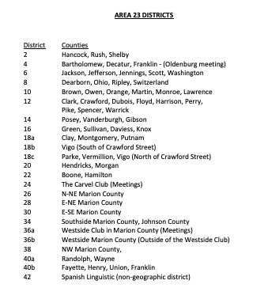
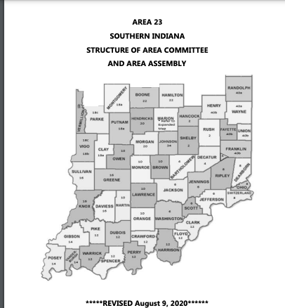
Area 23

Slide 16
Guardian of Traditions, and Being involved in Service work at the District and Area Level

Slide 17
Learn the Traditions from the “12 & 12" and "AA Comes of Age"

Slide 18
Roles and Responsibilities of the GSR and items that will help you successfully serve your group.

Slide 19
Be Prepared
Become familiar with and keep with you:
GSR Binder/Notebook
AA Service Manual
Area 23 Structure (Booklet)
Area 23 Guidelines (Booklet)

Slide 20
Attend District Meetings and Area Assemblies
How can you know what is happening at the District and Area level if you don’t attend the meetings.
Remember you carry information to and from the District and Area level to and from your Home Group.
Service Weekend—I can’t stress this enough! There is so much to learn at this function. There are workshops and every other year there is a voting Assembly. Your vote controls who is doing what at the Area! If you don’t think your vote counts, you need to attend a voting Assembly to see how one person’s vote can make a difference.
It is also important to ask for your group’s financial support for you to attend the Service weekend.

Slide 21
REPORTS TO THOSE YOU SERVE (Homegroup)
Highlight what is happening at the District and Area level. Are there any proposals that are coming up at the District or Area?
• Any new group officers or other service position holders.
• Who your alternate G.S.R. is.
• Any new group officers or other service position holders.
• What the average attendance is at group meetings.
• Any problems the group may be facing such as having to move, court referrals, dual
diagnosis members (alcoholism coupled with a mental illness), non-alcoholic addicts, lack
of interest in service, etc.
And, things you might report to your group include:
Have copies of the District, Area and the General Service Office Treasurer’s Reports for all to see.
• New district officers and other service people.
• News of any events or workshops you learned about at the district meeting.
Have copies of the Area Handout and Box 459. Pick a topic from Box 459 if you have time to discuss it.
• Things that you think the group can relate to or is interested or involved in.
• If there is an issue coming up that will require your vote, try to explain it as simply, fully,
and fairly as possible so that they can arrive at an informed group conscience.
Reimbursement from your Home Group
• How your group divides its funds for contributions.
Seventh Tradition

Slide 22
Excellent Resource The A.A. Group…Where it all begins (P-16)

Slide 23
A WORD ABOUT COMMITMENT --Ready, Willing, and Able
As members of the general service structure, those principles that we must now demonstrate as a
trusted servant include willingness, self sacrifice, honesty, consideration of others, thoughtfulness,
love, tolerance and, most of all, basic etiquette.
Do we show up when we say we will and are we on time?
Do we mark our A.A. commitments on the calendar and then work around them, or do we attend only if it doesn’t interfere with our own pleasure?
When we are unable to make an event that the G.S.R. should attend, do we arrange for our alternate to be there?
Do we keep our alternates well informed and involved?
Do we attend as many service activities as possible in order to become better informed, or do we do the least possible required?
Do we tend to our responsibilities cheerfully or portray them as a drag?
Are we able to offer criticism lovingly and based on the application of our three legacies, or do we let personalities get in the way?
All of these things are important to being committed to service in A.A., but the bottom line
is: Are we giving in proportion to what has been given to us?

Slide 24
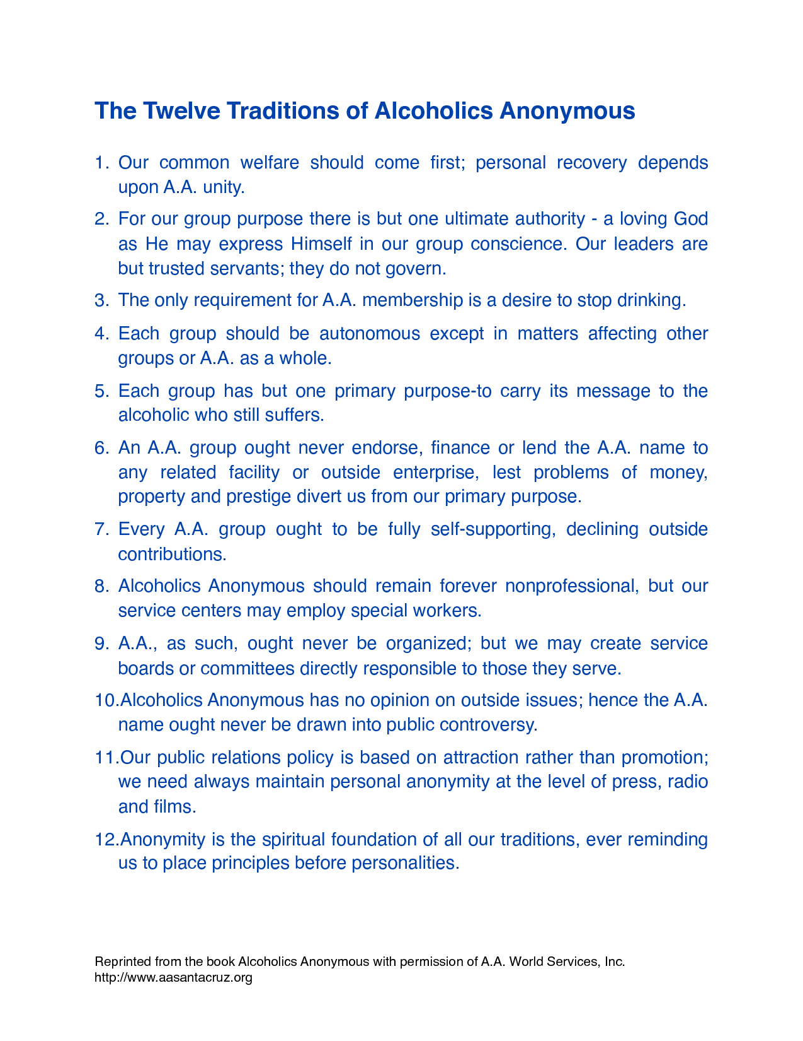

Slide 25
Thank you for joining me today
Responsibility Statement:
When anyone anywhere reaches out for help, I want the hand of A.A. to always be there, and for that I am responsible.

